Slide 1
MITRE Technical Presentation Senior Design Project – Solid State Timer Patrick Dunham 2017-11-05

Slide 2
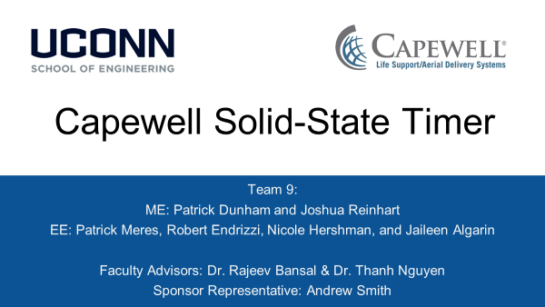

Slide 3
Presentation Outline
Background
Milestone 1
Milestone 2
Milestone 3
Milestone 4
Conclusions

Slide 4
Background – Outline
Background
Sponsor
Project Statement
Specifications
Milestone 1
Milestone 2
Milestone 3
Milestone 4
Conclusions

Slide 5

Background – Sponsor
Supplies products for aerial delivery, life support, and military tactical gear
Owner of multiple smaller companies, including Marktime
Marktime specializes in mechanical timing devices

Slide 6
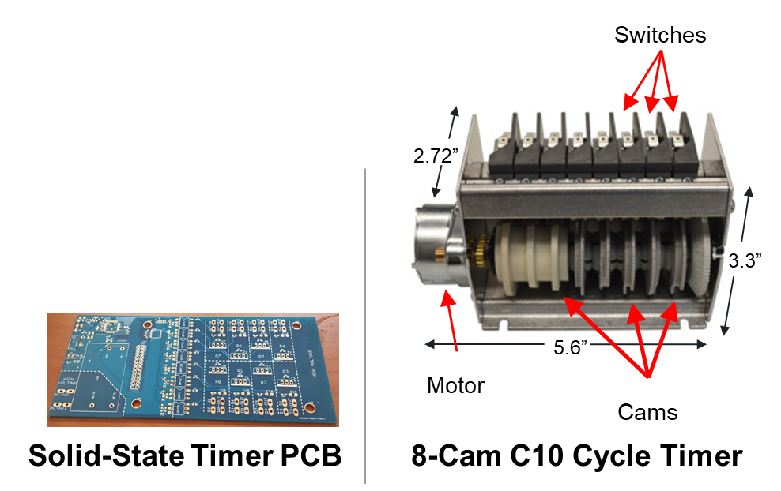
Background – Project Statement
Goal:
Design a solid state drop-in replacement for the C10B Electromechanical Cycle Timer. The replacement must meet or exceed the current design in all aspects.
Deliverables:
PCB Design / Schematic
Microcontroller Source Code
Functional Prototype

Slide 7
Background – Specifications
Power:
Average power draw must be below 3 W.
Each relay must have a maximum rated load of 15 A @ 120 VAC
Timer:
Must control 8 independent devices
Cycle length must be adjustable between 60 – 120 seconds
Must be both factory- and user-programable
Production:
Must cost $40 or less, not including labor
Must match installation footprint of current cycle timer
User Interface:
Must have easily trainable/intuitive interface. Factory interface must allow for lockout of individual device timing changes

Slide 8
Milestone 1 – Outline
Background
Milestone 1
Design Approach
Team Organization
Milestone 2
Milestone 3
Milestone 4
Conclusions

Slide 9
Milestone 1 – Design Approach
Research Components
TRIACs, SCRs, Relays…
Power Supplies
User Interfaces
Test Circuit
Verify circuit operation
Verify PCB design
Measure component temperatures
Compare to PSPICE model predictions
Design Enclosure
Protect sensitive electronics
Match current enclosure footprint
Manage heat dissipation

Slide 10
Milestone 1 – Team Organization
5 Components + System Management:
Enclosure - Joshua Reinert [ME]
Relays - Jaileen Algarin [ECE]
Microcontroller - Patrick Dunham [ME / ECE]
Power Supply - Robert Endrizzi [ECE]
User Interface - Nicole Hershman [ECE]
Systems - Patrick Meres [ECE]
Weekly meetings with faculty advisors
Monthly meetings with corporate sponsor
Google Drive for file-sharing/design notebook
Lab Space in ITE C43

Slide 11
Milestone 2 – Outline
Background
Milestone 1
Milestone 2
Microcontroller Updates
Relay Updates
Power Supply Updates
User Interface Updates
Enclosure Updates
Milestone 3
Milestone 4
Conclusions

Slide 12
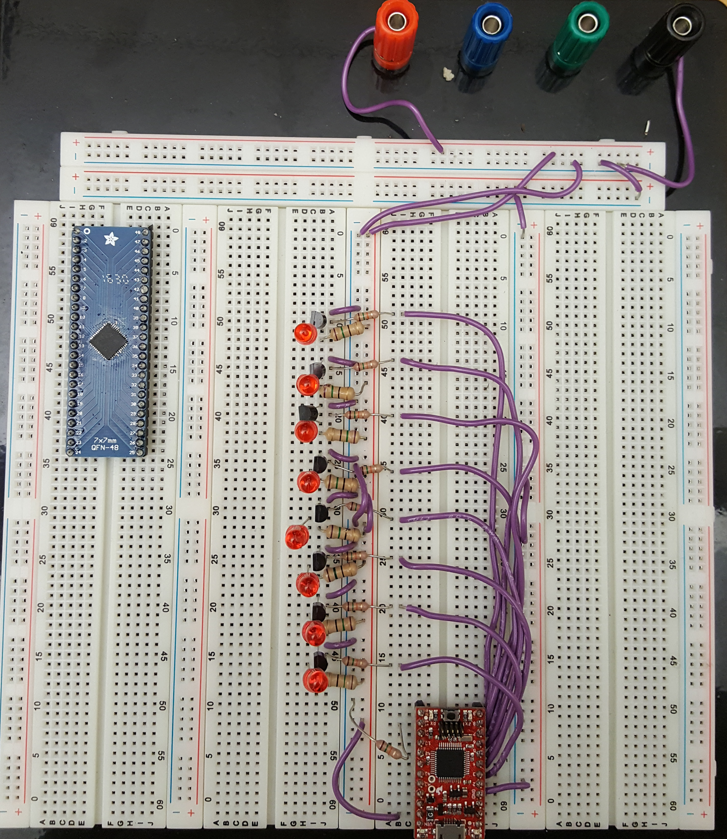
Milestone 2 – Microcontroller Operation
Firmware based on 3-state state machine
Idle State: “Pauses” the cycle, remembering last location
Cycle State: Runs through the stored cycle, switching on and off relays
Reset State: Resets the cycle, preparing the device for a new run

Slide 13
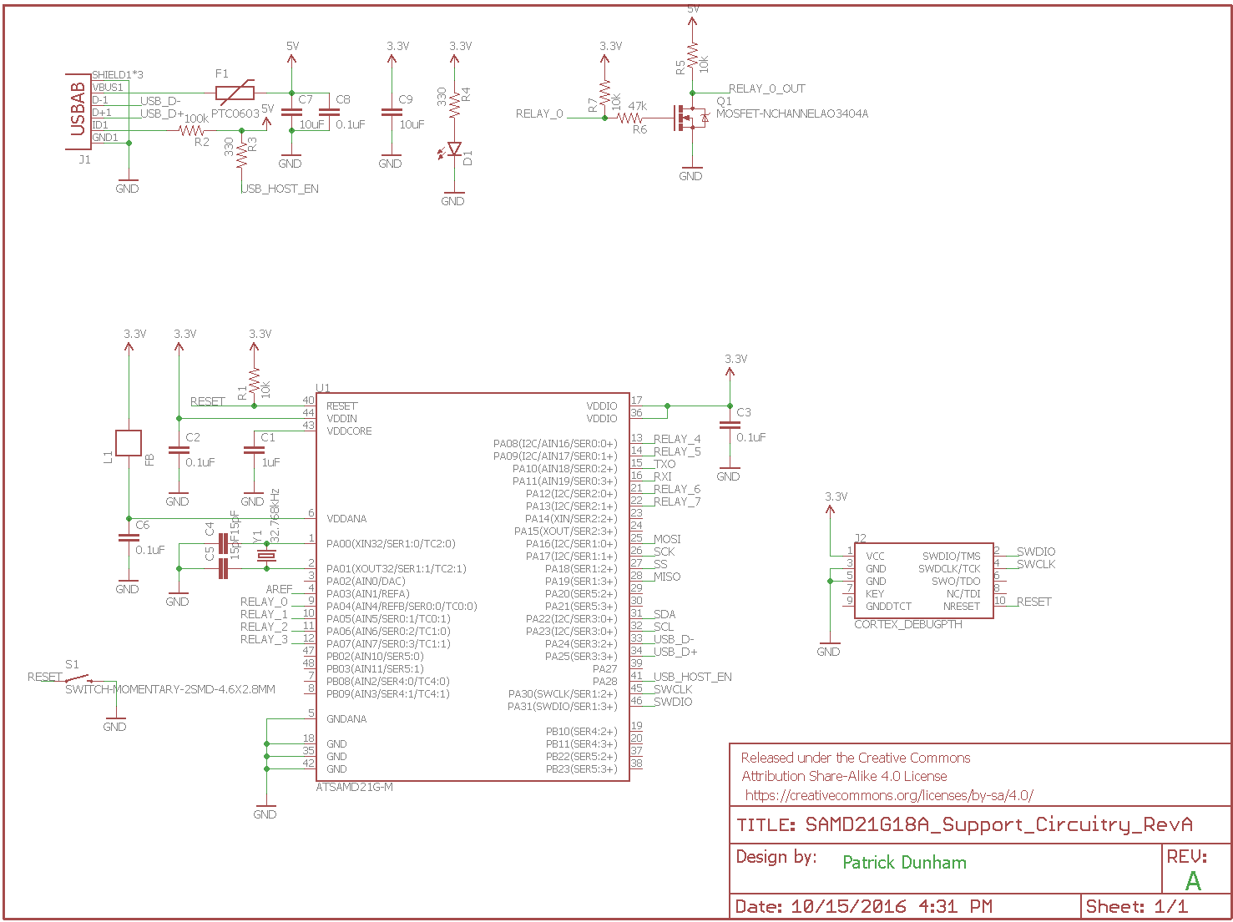
Milestone 2 – Microcontroller Schematic

Slide 14
Milestone 2 – Microcontroller Schematic
USB Connector
Relay Control
Microcontroller

Slide 15
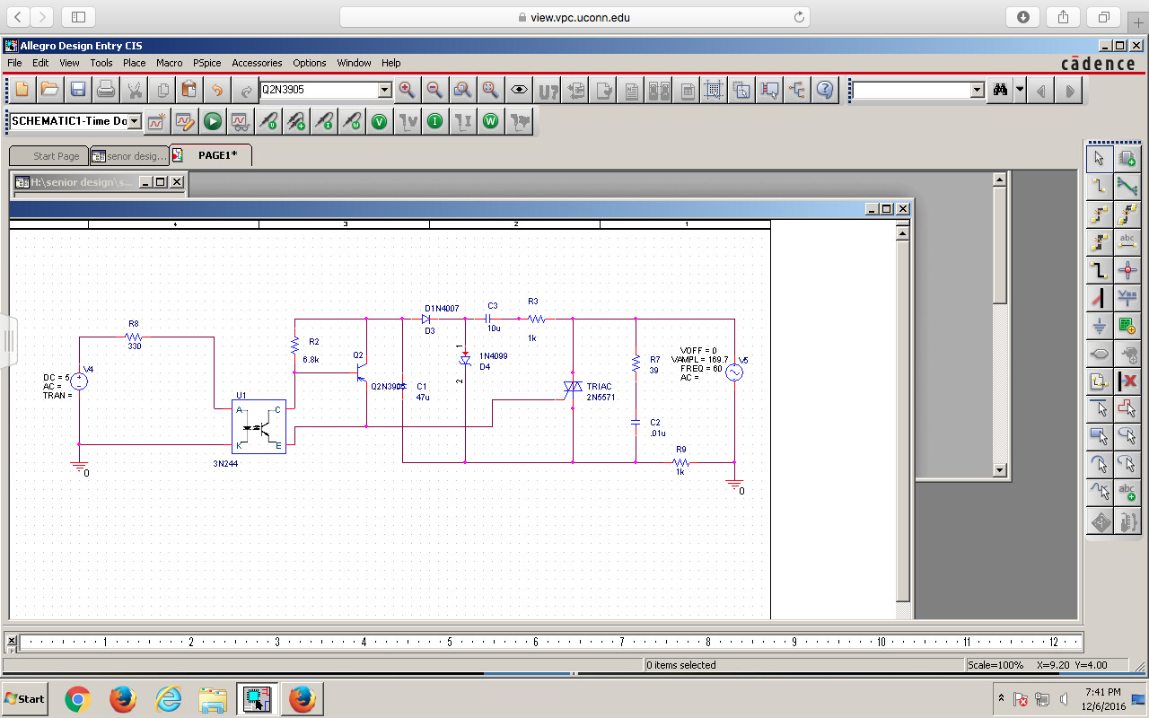
Milestone 2 – Relay Schematic

Slide 16
Milestone 2 – Relay Schematic
Optoisolator
TRIAC Driver
TRIAC

Slide 17
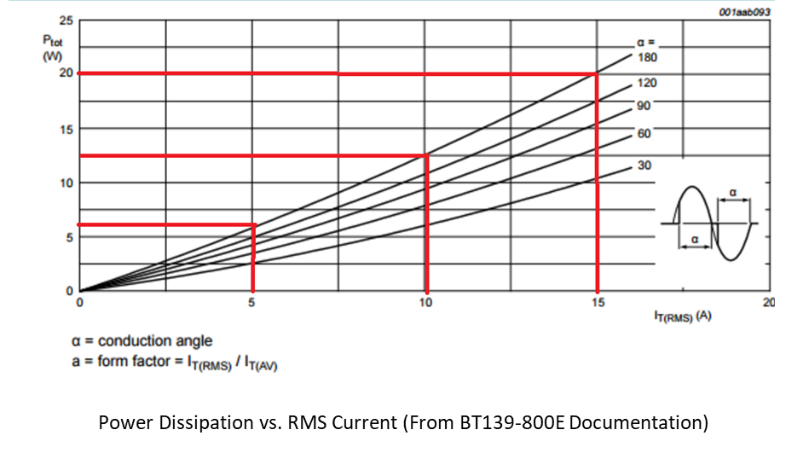
Milestone 2 – Relay Power Output
R_{TH}(w/o heatsink) : 60 K/W
At 15 A, 15 W of heat is produced (∆T > 900 K!)
Ambient Temp = 60 C
Max Device Temp = 125 C
Need heatsink w/ R_{TH}< 3.13 K/W

Slide 18
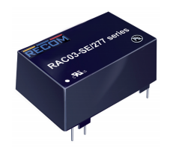
Milestone 2 – Power Supply Solution
Board-mount AC/DC Converter
~$15 Unit Cost
3W output @ 5VDC
Input Voltage: 85 – 264 VAC

Slide 19
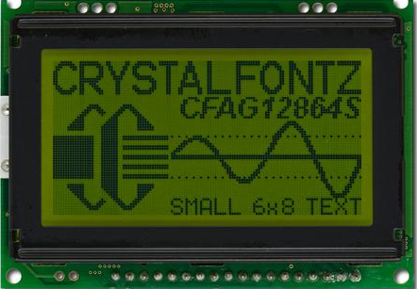
Milestone 2 – UI Hardware
Graphic LCD Screen:
128x64 Display
Size: 2.953 in x 2.075 in x 0.35 in
8-bit parallel interface
-20 to +70 degrees C
Buttons:
PCB-Printed Capacitive Buttons

Slide 20
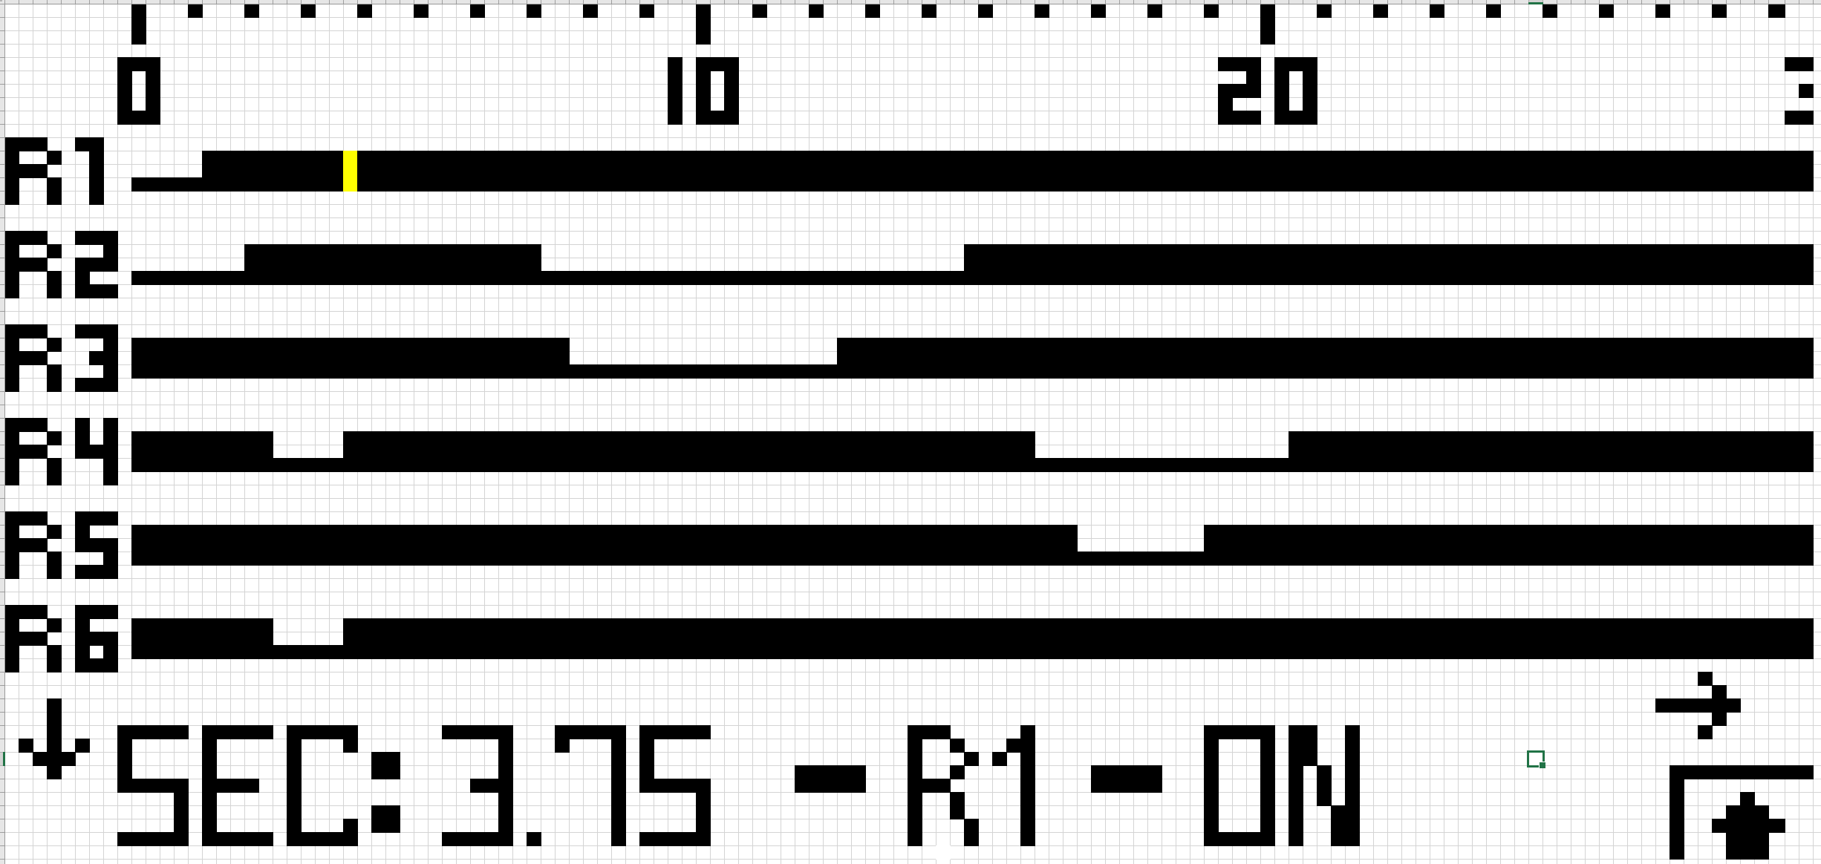
Milestone 2 – UI Design

Slide 21
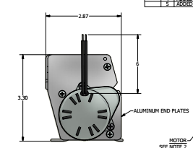
Milestone 2 – Enclosure
Design must match original enclosure footprint
Does not need to be dustproof/waterproof
Concerns are responsibility of customer
Full enclosure not needed!!!

Slide 22
Milestone 3 – Outline
Background
Milestone 1
Milestone 2
Milestone 3
Microcontroller Updates
Relay Updates
Milestone 4
Conclusions

Slide 23
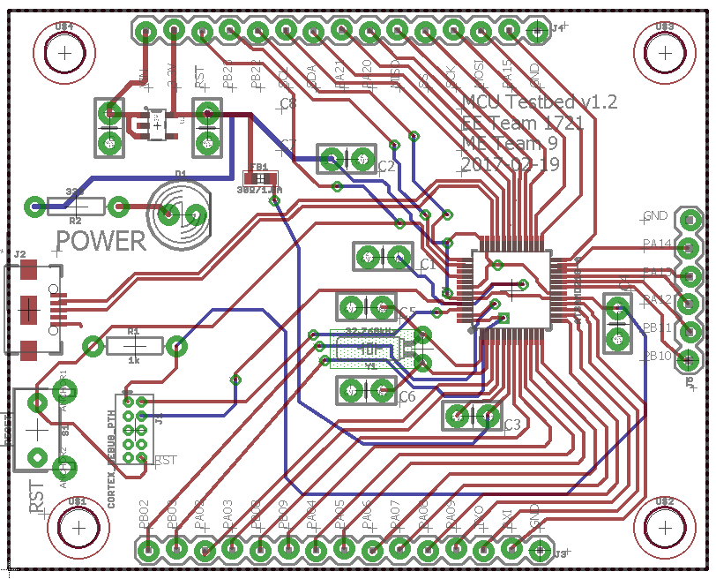
Milestone 3 – Microcontroller Board Layout
2.0”
2.0”

Slide 24
Milestone 3 – Microcontroller Board Layout
Power
USB
Microcontroller
Programming

Slide 25
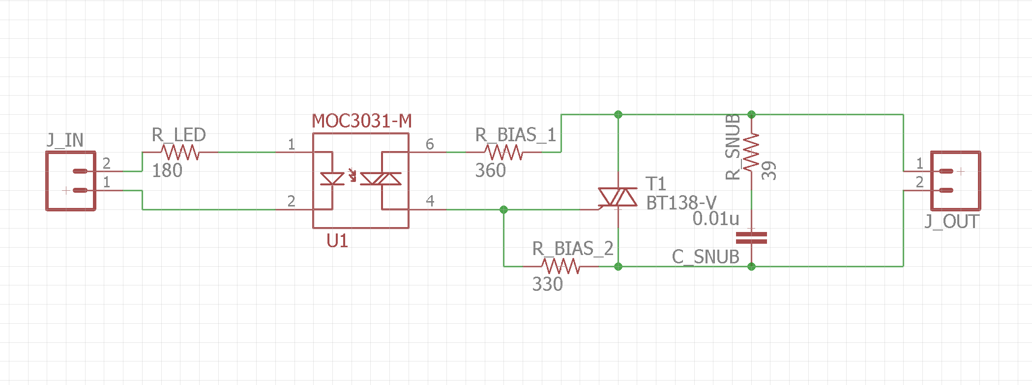
Milestone 3 – Relay Schematic

Slide 26
Milestone 3 – Relay Schematic
Optotriac
TRIAC
Load

Slide 27
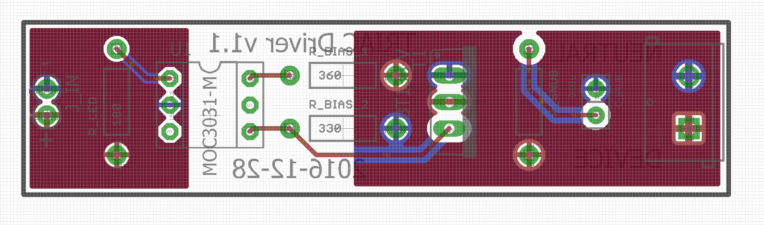
Milestone 3 – Relay Board Layout

Slide 28
Milestone 3 – Relay Board Layout
Optotriac
TRIAC
Load

Slide 29
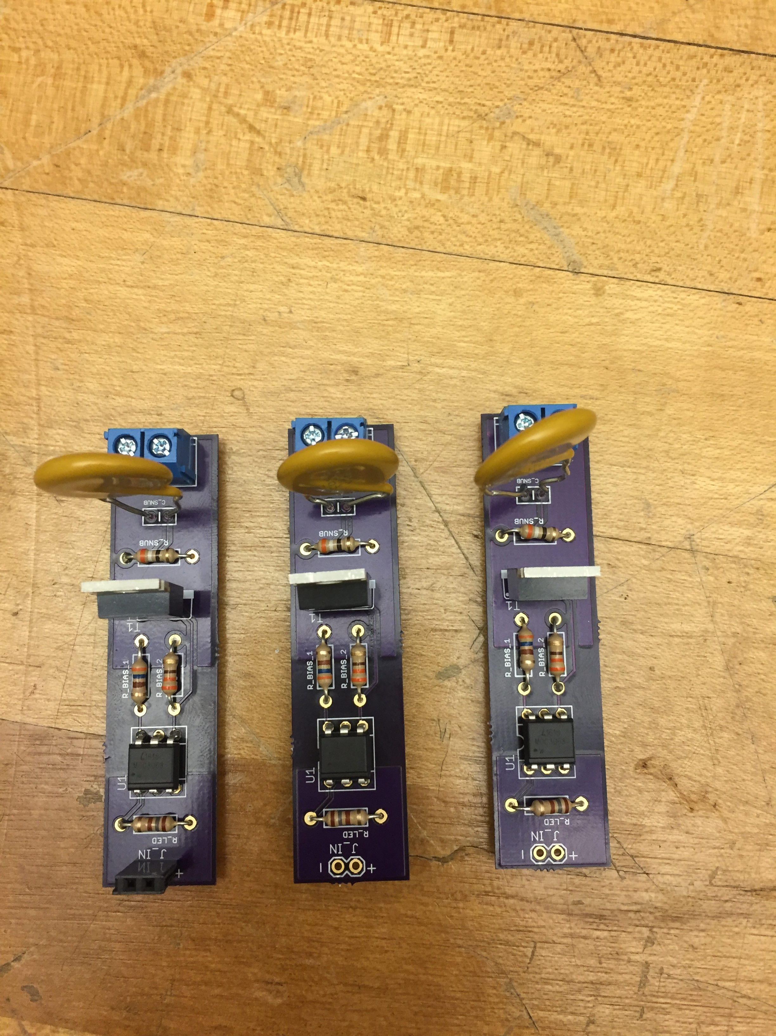
Milestone 3 – Relay Board Layout

Slide 30
Milestone 4 – Outline
Background
Milestone 1
Milestone 2
Milestone 3
Milestone 4
PCB Updates
Microcontroller Updates
Relay Updates
User Interface Updates
Conclusions

Slide 31
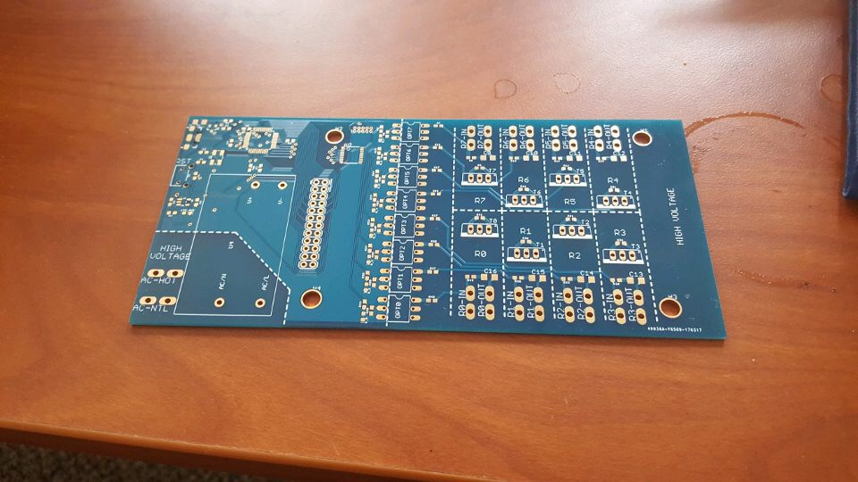
Milestone 4 – PCB Revision 1
2.82”
6.02”

Slide 32
Milestone 4 – PCB Revision 1
Microcontroller
Relays
Power

Slide 33
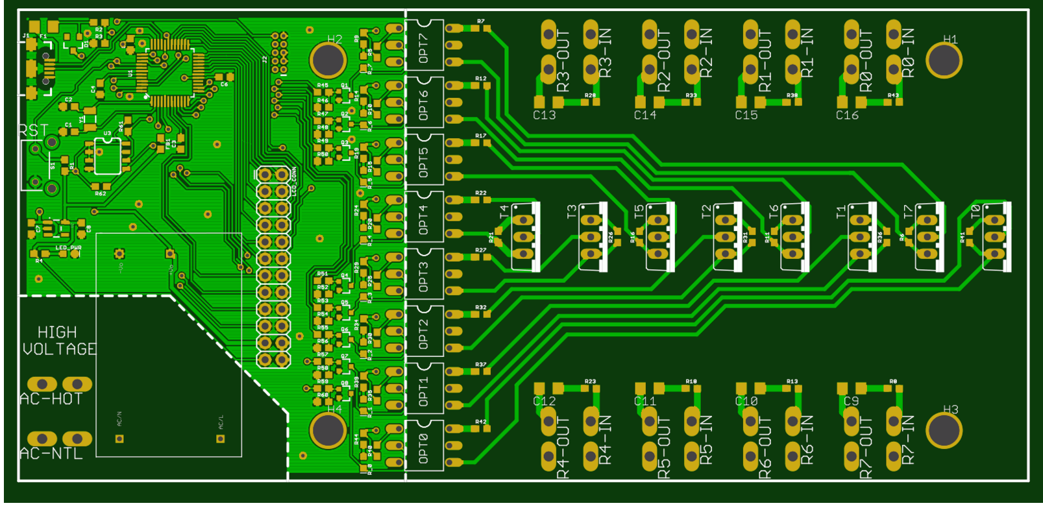
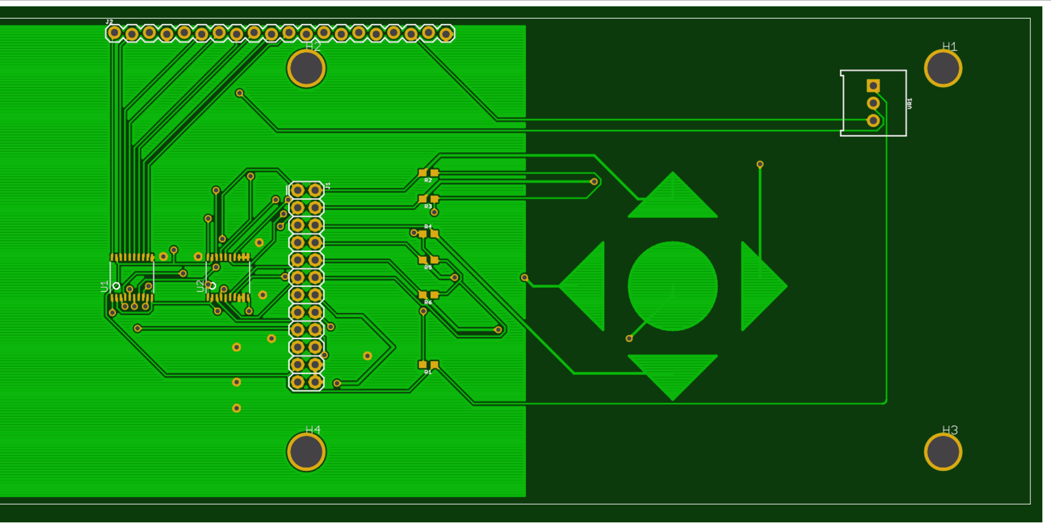
Milestone 4 – PCB Revision 2
Timer PCB
LCD PCB

Slide 34
Milestone 4 – PCB Revision 2
MCU
Relays
LCD
Buttons
Power
Timer PCB
LCD PCB

Slide 35
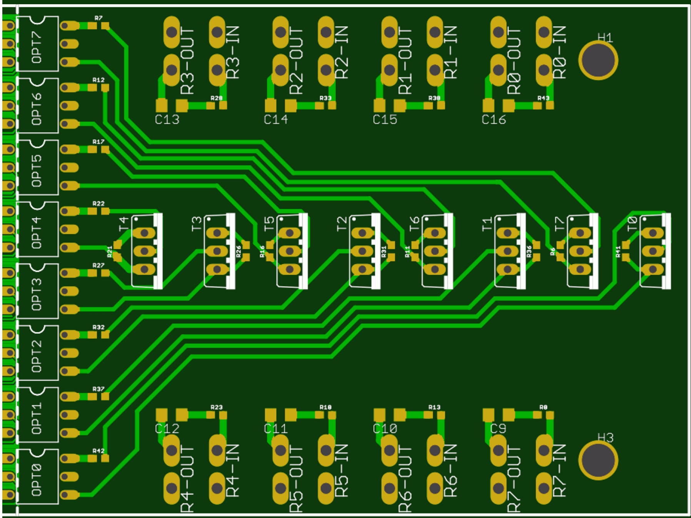
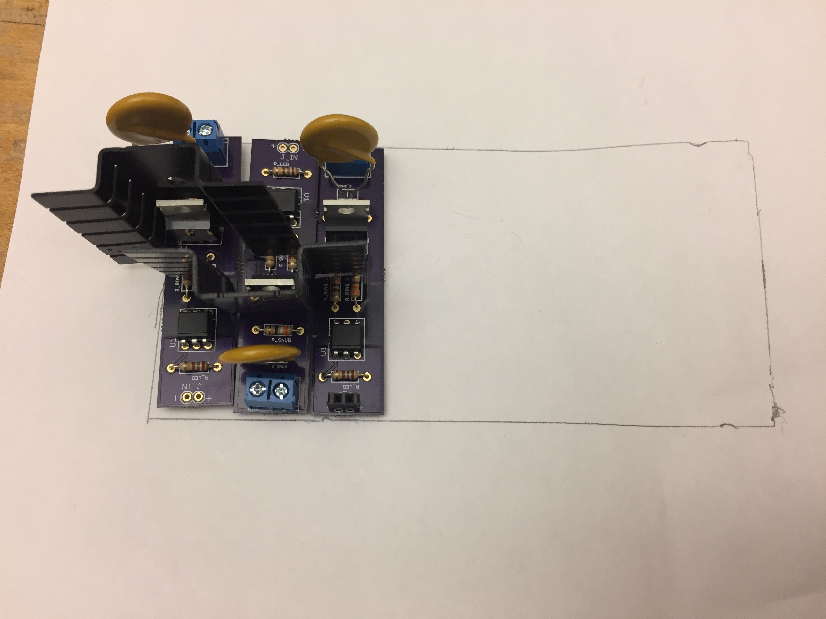
Milestone 4 – PCB Issues
Original Design
Relays not soldered in picture – too close for heatsinks
New design – no staggering required!

Slide 36
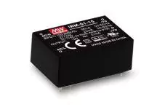
Milestone 4 – PCB Issues
PCB design doesn’t match footing
Rev. 2 PCB has correct footing
Cheaper custom solution simulations successful
-BUT-
Less expensive module discovered!!!
Old PSU
New PSU

Slide 37
Milestone 4 – PCB Issues
PROBLEM: Original mechanical timer receives power ONLY when dishwasher is running
Drop-in replacement design matches that expectation
Illogical to have to run dishwasher to adjust cycle times
SOLUTION: Physical switch added to switch modes
Run Mode – Run dishwasher as normal
Programming Mode – Turn on display, allow user to change programming.

Slide 38
Milestone 4 – UI Issues
PROBLEM: Current LCD Malfunctioning
LCD will no longer respond to commands
Old, working code no longer works
SOLUTION: Order new LCD, test code
LCD is likely broken. A new module should fix it
Failing this, another screen model is available

Slide 39
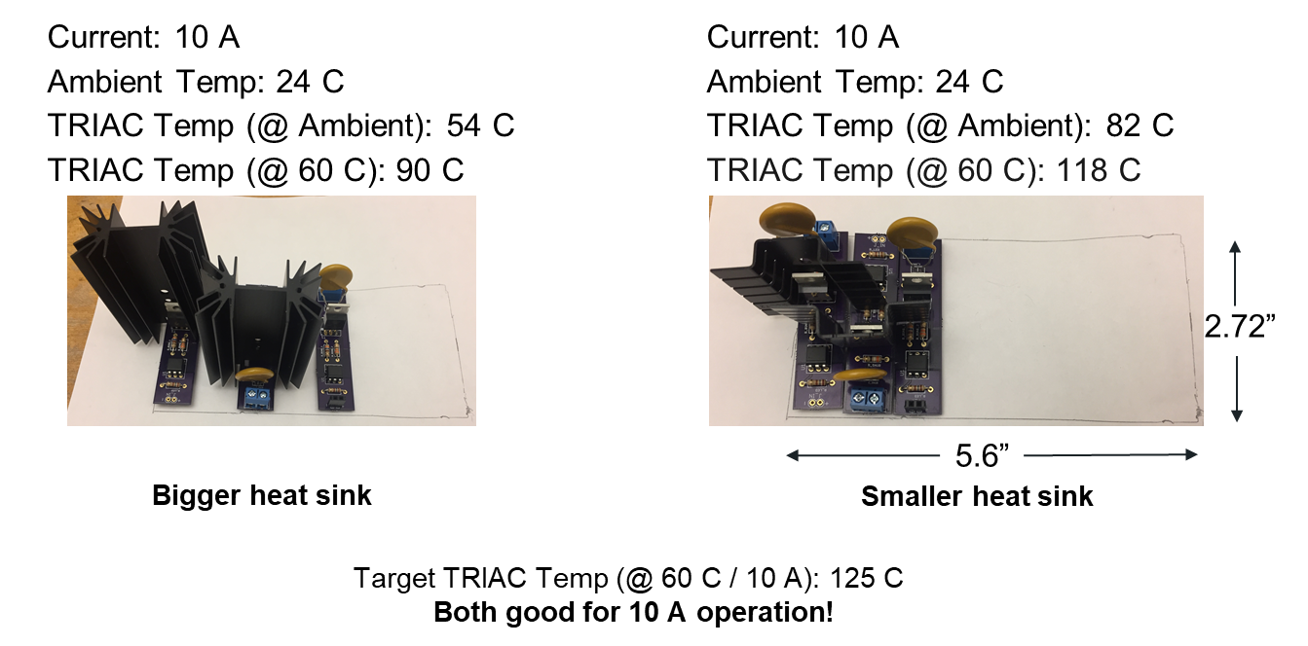
Milestone 4 – Relays

Slide 40
Conclusions – Outline
Background
Milestone 1
Milestone 2
Milestone 3
Milestone 4
Conclusions
Estimated Unit Cost
Final Design Changes
Future Goals

Slide 41
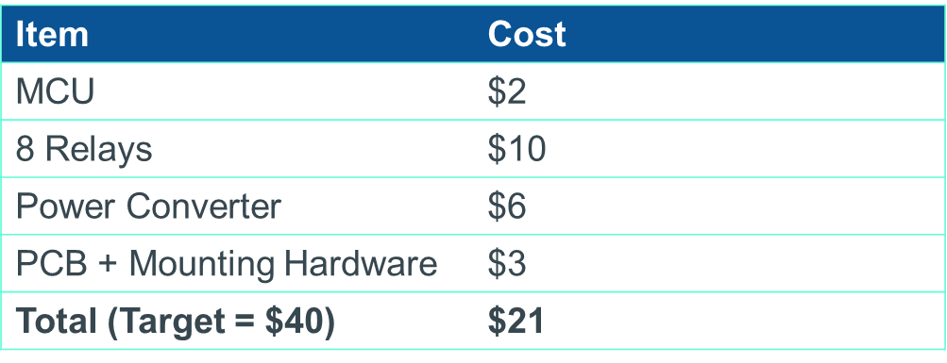
Conclusions – Estimated Unit Cost

Slide 42
Conclusions – Final Design Changes
Smaller Microcontroller Used
256kB memory is significantly larger than needed
Reducing to 32kB does not change code, reduces unit cost by $1
LCD Panel / PCB Not Used
New LCD still did not work with existing code
Components were deemed too expensive for functionality added
Command-line interface over USB used instead

Slide 43
Conclusions – Future Goals
Replace TRIACS with SMD Variants
Use custom heatsinking solution
Implement smaller, cheaper power supply
Redesign code to allow for PWM control of connected devices

Slide 44
Questions?

